Slide 1
Bud Box
MEMSDuino
Lafe Spietz
NIST
Summer 2024

Slide 2
Tools and parts
Bud Industries AN-1304-A diecast aluminum box: $12.93
Assmann A-DF 25 PP/Z DB25 board mount connector: $1.17
McMaster Carr 91075A462 4-40 standoffs: 2x$3.73 = $7.46
4-40 tap
#43 drill bit for 4-40 tapped holes
1/8” mill tool
3/8” mill tool
Center drill
1/8” drill bit
(none of these machine tools are needed if you outsource the machining)

Slide 3
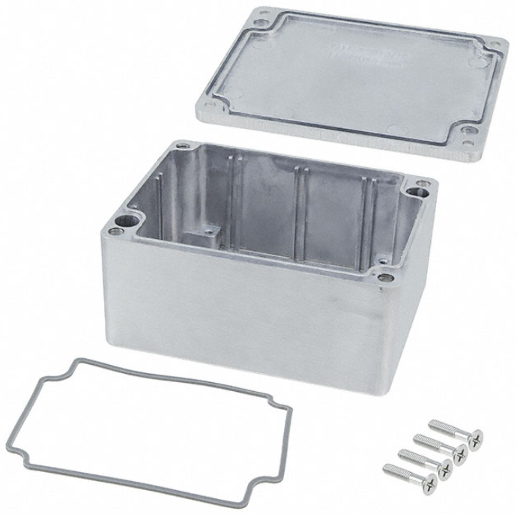
AN-1304-A Diecast Aluminum Enclosure from Bud Industries
https://www.onlinecomponents.com/en/productdetail/bud-industries/an1304a-48608718.html

Slide 4
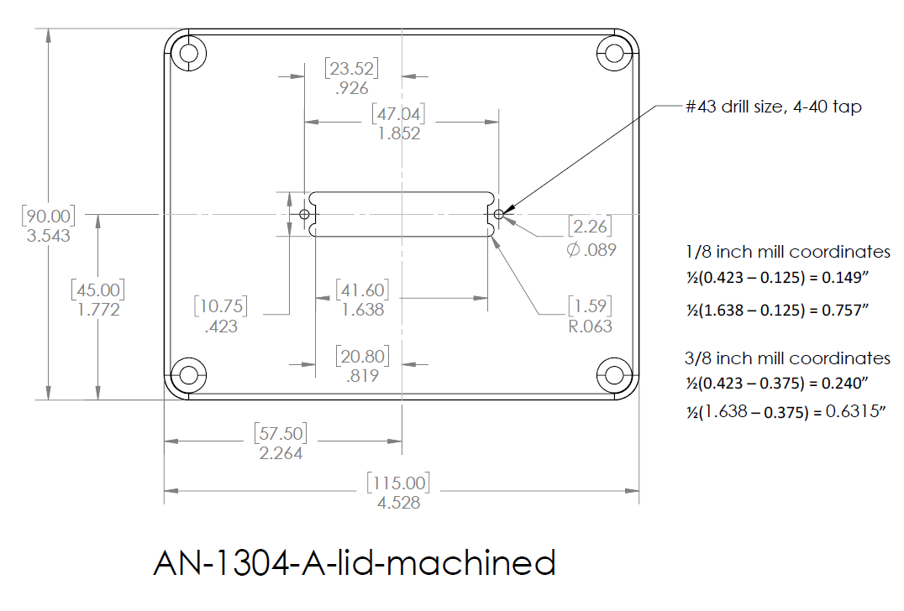

Slide 5
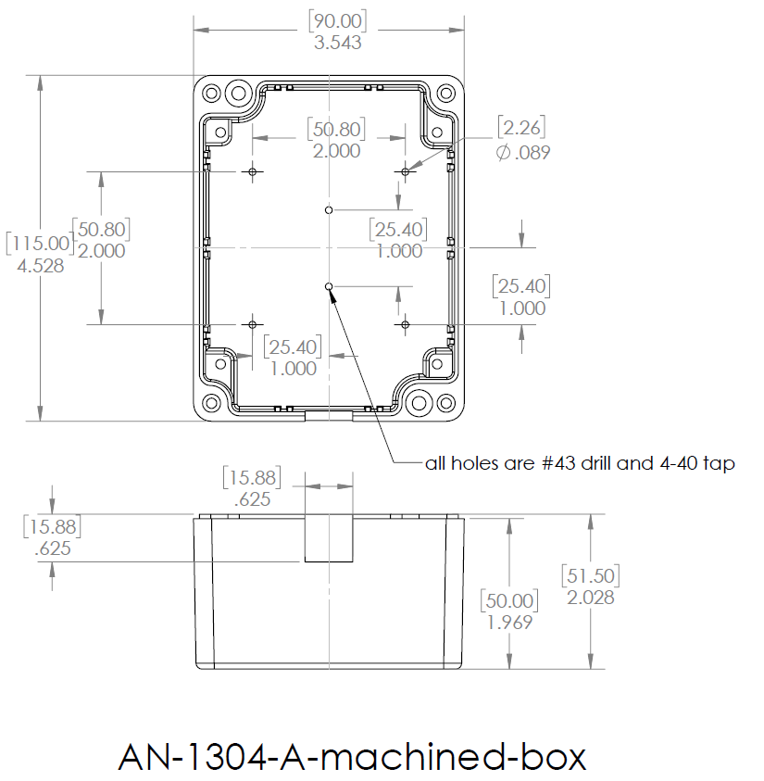

Slide 6
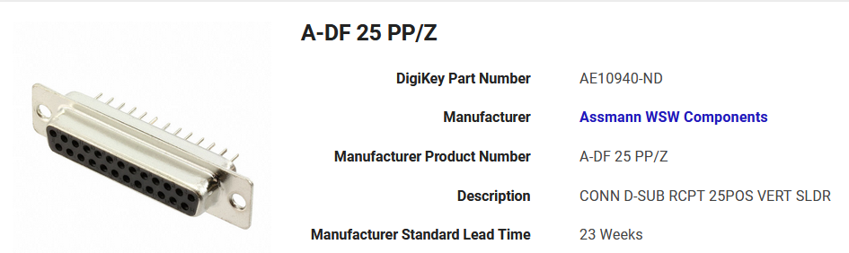
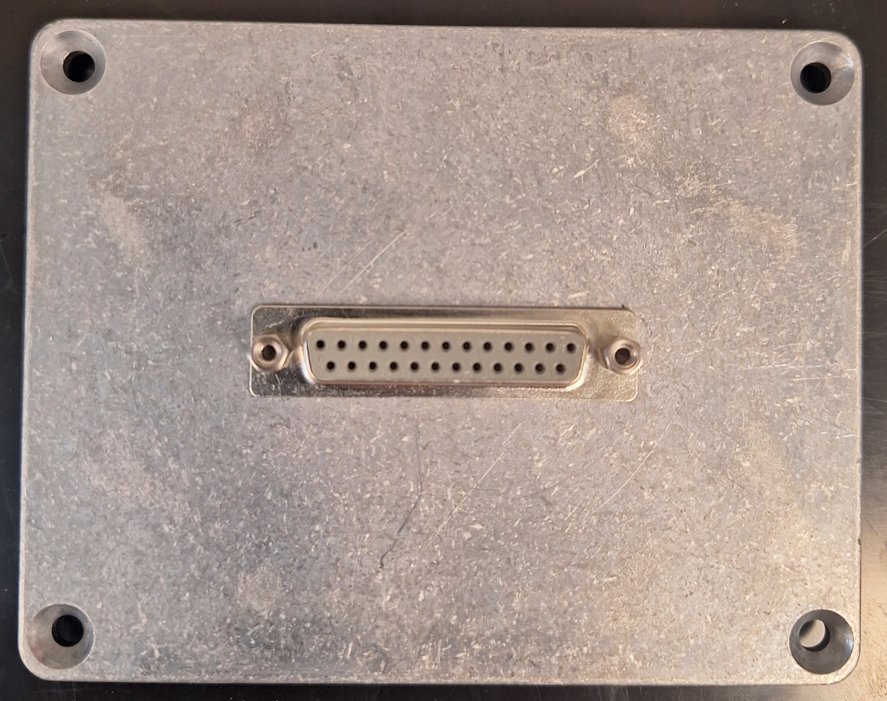
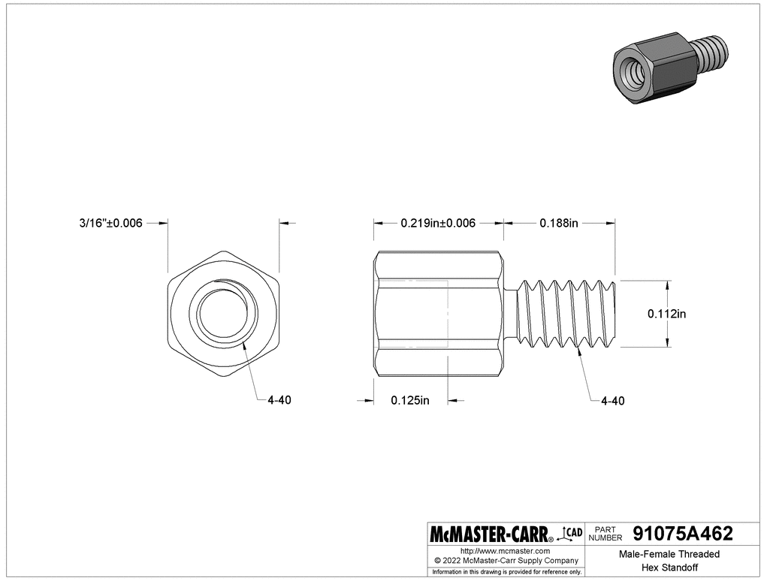
Dsub Lid Assembly
https://www.digikey.com/en/products/detail/assmann-wsw-components/A-DF-25-PP-Z/1241794
Use pliers to tighten standoffs
https://www.mcmaster.com/91075A462/

Slide 7
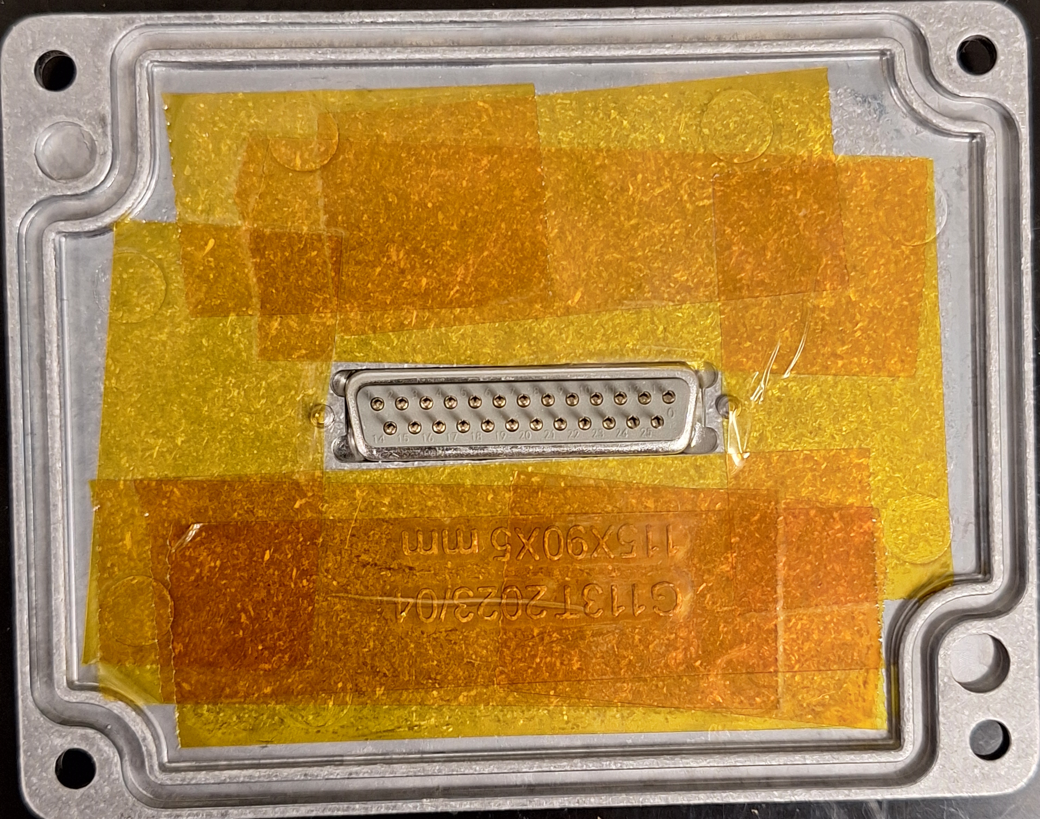
Adding polyimide tape to the lid
This must be assembled before the circuit board is soldered to the DB25 connector!
Prevent potential shorts

Slide 8
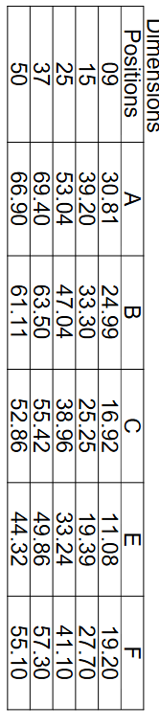
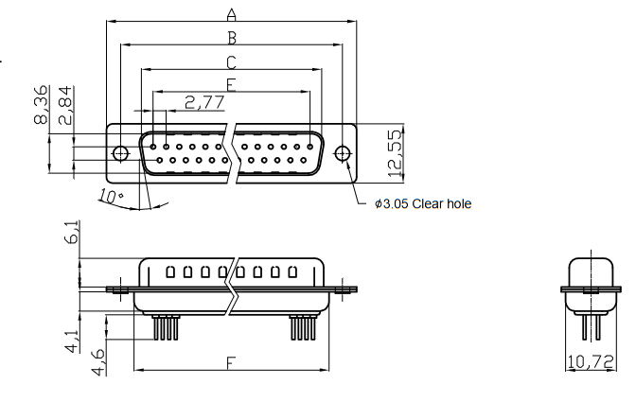
Board mount/panel mount DB25
No. 43
Cutout is 10.72 mm x 41.10 mm

